Slide 1
Notes:
Bullet Points:
This is an Intro Screen, You can introduce yourself and thank them for taking the time to discuss their project.
Transition: AM Roofing teams up with some of the absolute best in the business, like Owens Corning

Slide 2
Owens Corning
A World Leader in Building Material Solutions
for Over 70 Years!
Notes:
Bullet Points:
The main point of this slide is to build trust with your customer. Owens Corning is a very recognizable name that they’ve heard of before. What they don’t realize is that OC has been a world leader in building materials for over 70 years! This partnership shows the stability of choosing a company like AM Roofing for their job.
Transition: Owens Corning has built such a fantastic reputation by continuing to innovate through the years

Slide 3
1938 - Invented Commercial Fiberglass™
Owens Corning: A Company of Innovation

Slide 4
1953 - Automobile Bodies
Owens Corning: A Company of Innovation

Slide 5
1963 - Space Suits
Owens Corning: A Company of Innovation

Slide 6
1978 - First Fiberglass™ Shingle
Owens Corning: A Company of Innovation

Slide 7
2014 – iPhone 6 & 6 Plus™ S-GLASS
Owens Corning: A Company of Innovation

Slide 8
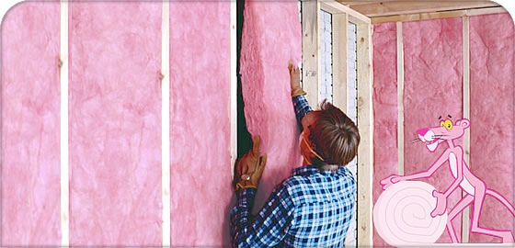
99% of People are already customers
Notes:
Bullet Points:
Show how most people in the world are already Owens Corning Customers. We touch peoples lives everyday!
Transition: When Owens Corning went looking for the best people in Canada they found AM Roofing!!

Slide 9
A Team You Can Count On: Owens Corning & YOUR COMPANY
Notes:
Bullet Points:
Explain the partnership of AM Roofing and Owens Corning. Emphasize that by choosing you, they will have a job that is backed by the world leader in building products.
Transition: AM Roofing brings world class service to you.

Slide 10
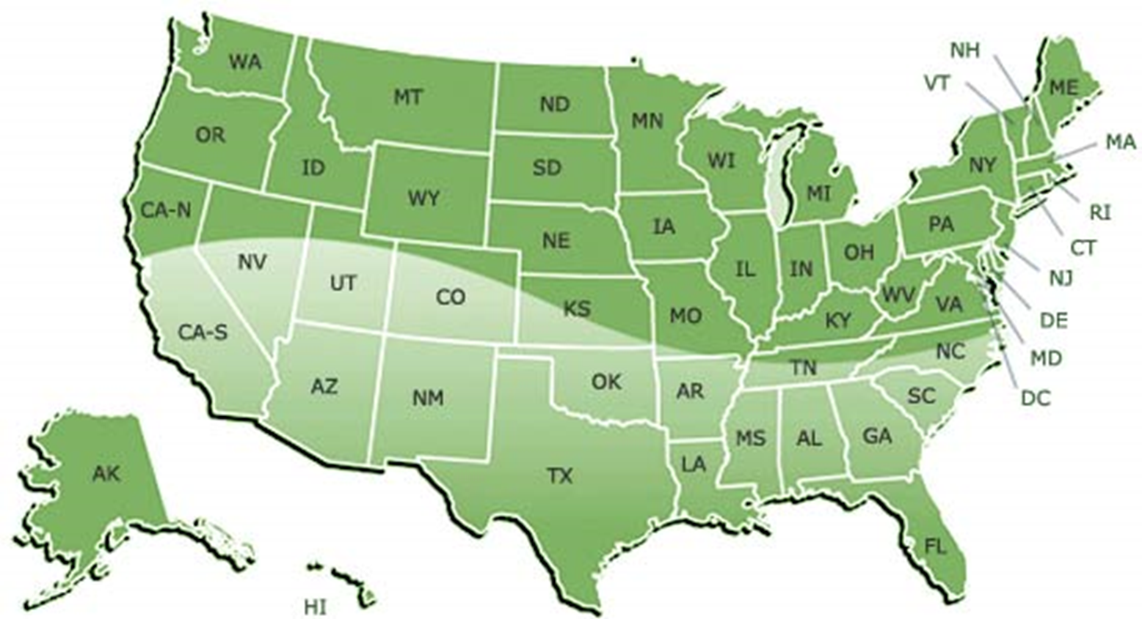
Serving THOUSANDS of Satisfied Customers!!!
Notes:
Bullet Points:
This Slide is used to transition from talking about OC to talking about Exceptional Exteriors.
We also use this slide to show how many customers we have served and set ourself up as a local company that they can trust.
Transition: The reason we have grown is our team

Slide 11
FAMILY OWNED AND OPERATED

Slide 12
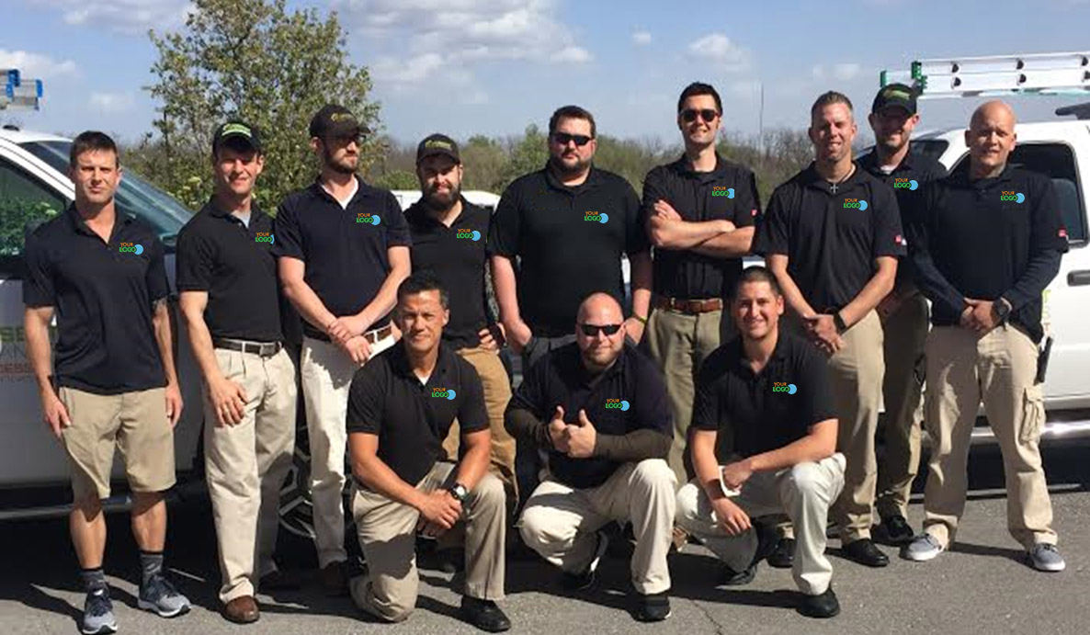
Our Team
Notes:
Bullet Points:
Show our team and point yourself out.
Transition: We are also give back

Slide 13
We Give Back
Notes:
Bullet Points:
Explain the charities we give back to.
Transition: We have won award after award

Slide 14
Your Company is trusted by the best!
Notes:
Bullet Points:
Show some of the Local and National organizations that we belong to, and then set up the BBB logo to pop in.
Once again, timing is critical.
Transition: The BBB, being the consumer watchdog of the industry, has some startling facts!

Slide 15
SOME STARTLING FACTS!
Roofing Contractors #1 on hit list!
3.4 MILLION COMPLAINTS!
80% of consumers taking lowest bid had MAJOR PROBLEMS in getting job completed.
96%
of all contractors FAIL
within first two years!
*Source: Annual Summary, the Council of Better Business Bureaus (CBBB) 2005 price quotation.
Notes:
Bullet Points:
Bring in the facts, One at a time.
Discuss the facts, before you bring in the text. This screen is VERY powerful when delivered properly.
Transition: There are many steps that AM Roofing takes to make sure that you do not become a statistic. One of those is insurance.

Slide 16
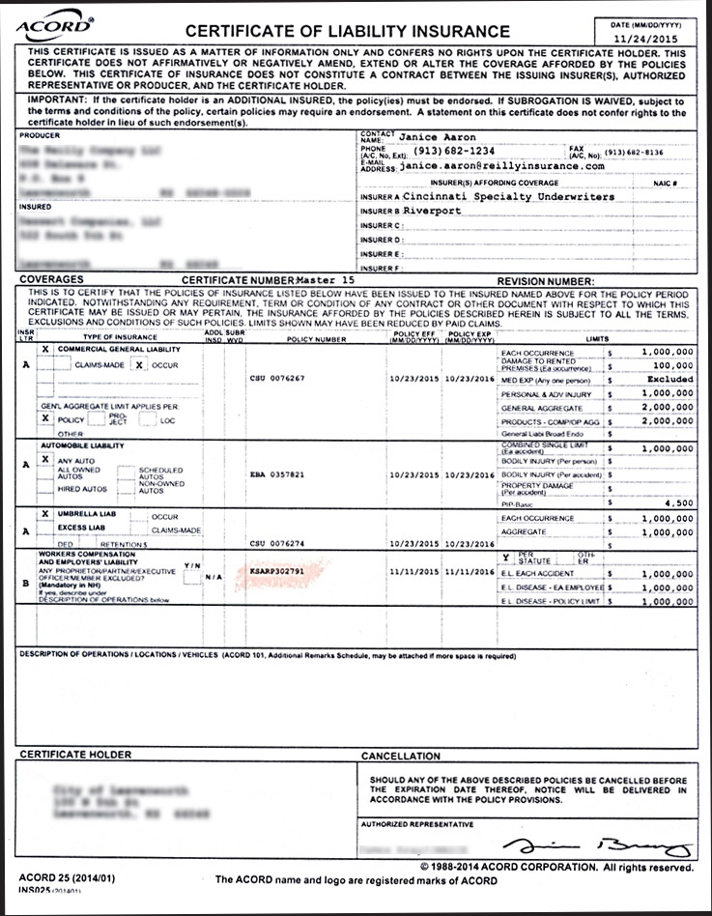
Fully Insured To protect you
Notes:
Bullet Points:
This screen shows that we have millions in general liability and workman's compensation insurance. This is huge. Many roofers carry handyman insurance that won’t cover anything if they’re on a roof.
We pay tens of thousands of dollars per year to make sure that you are protected. Though it may cost us a little more, we feel that you and your family are worth every penny!
Transition: Another reason we have become the leader in the country is training.

Slide 17
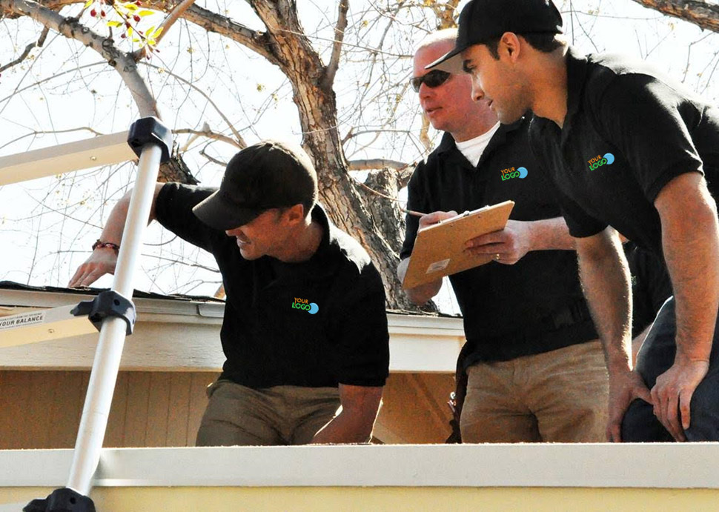
ON THE JOB TRAINING

Slide 18
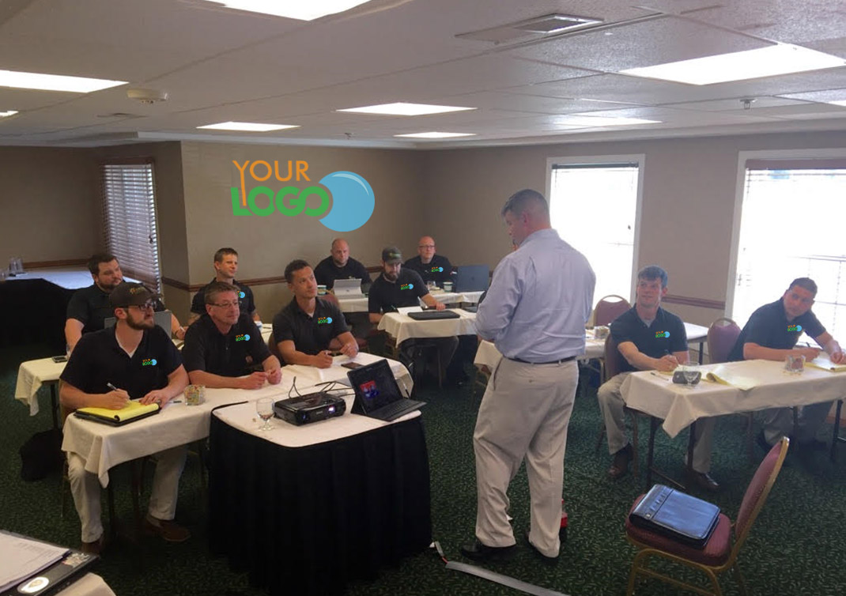
CLASSROOM TRAINING

Slide 19
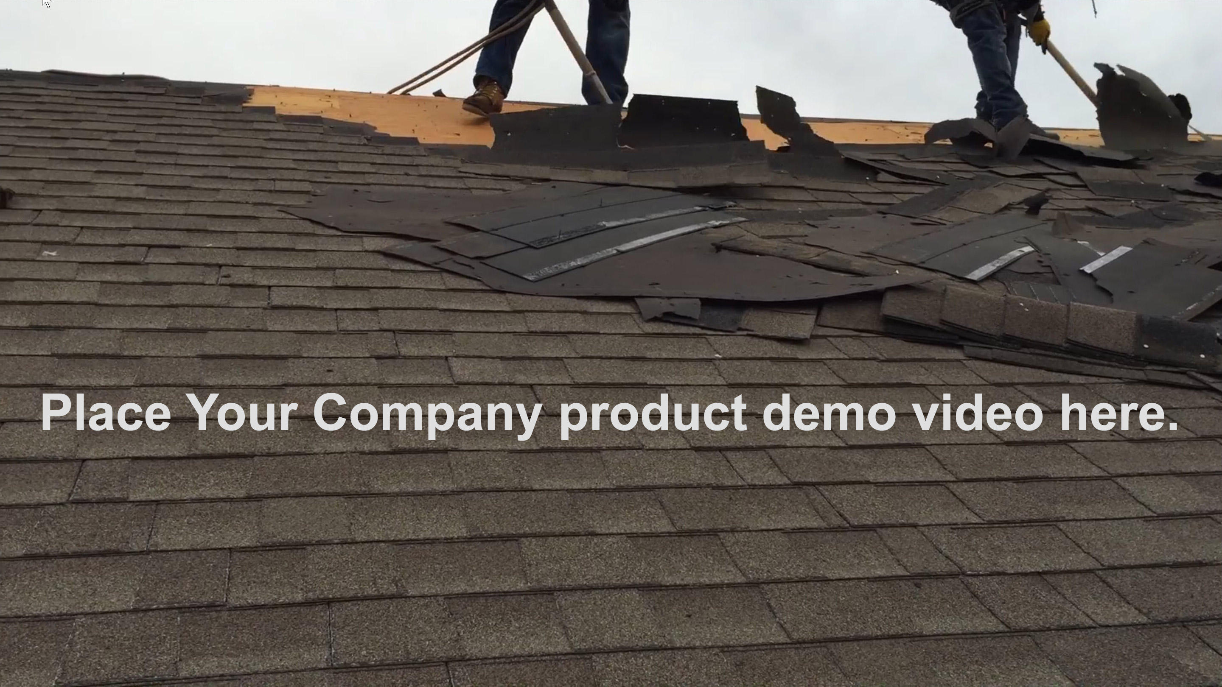
The Installation Process
Notes:
Bullet Points
You must practice this slide to make sure you can talk through the movie and know what is coming next. By doing this it will make you look like the ultimate professional!
Transition: Everyone wants a Exceptional Exterior roof. The only question is whats it going to cost? We have a source for that.

Slide 20
The “Blue Book” of Home Improvement
2015 Average Cost
$19,528
2005 Average Cost
$11,164
Notes:
Bullet Points:
This screen brings a third party source in to help you justify the price of your roof. Set up Remodeling Magazine Cost vs Value Report to be the Blue Book of the Remodeling Industry.
Some of the biggest publications in the industry, like Money Magazine and Consumer Reports, quote Remodeling Magazine.
Transition: Let me show you the steps we take in order to get you the roof that you and your family deserve.

Slide 21
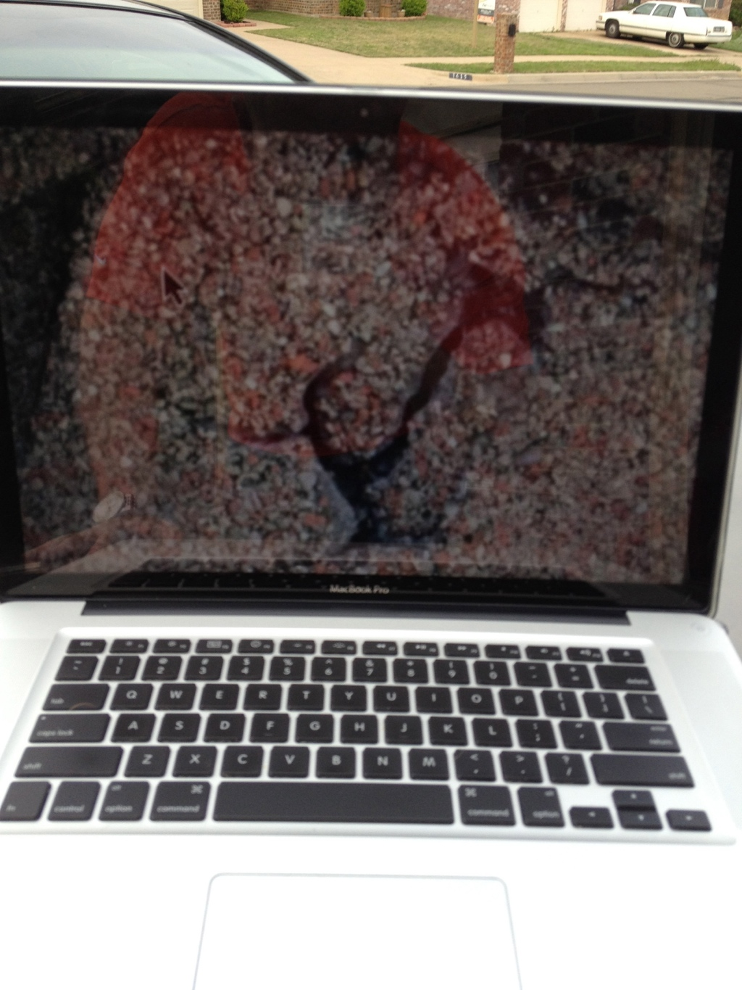
First Step
Inspect the roof and Do Digital Analysis
Notes:
Bullet Points:
This is the time to walk them through the process. We want to let them know that the first thing we will be doing is a thorough survey of their roof. We will take a video and make a detailed drawing of the roof.
Transition: After we determine that your roof has significant damage, we help you make a claim to your insurance company.

Slide 22
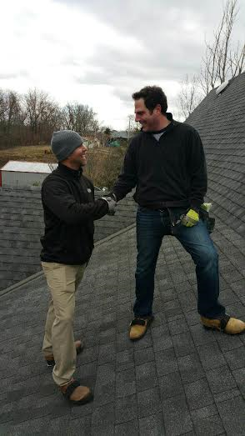
Next Step
Meet with your Adjuster

Slide 23
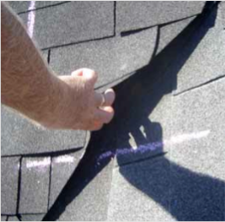
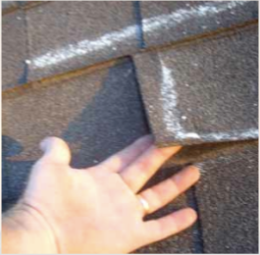
we make them look CLOSER
Notes:
Bullet Points:
Pictures like these, as well as a trained Exceptional Exteriors representative to meet with the adjuster, has led us to get almost all of our customers approved.
Transition: Once we get your roof approved and you get a check, a lot of people think that they need to get estimates. Let me show you why that is a BIG mistake.

Slide 24
Low Bids don’t save you $$$
Chuck and a Truck
Your Company’s Way
$10,000 Total Claim
-$1000 Deductible
$9,000 Insurance payout available
$10,000 Total Claim
-$1000 Deductible
$9,000 Insurance payout available
Insurance will cut you a check for $6,000
Insurance will cut you a check for $6000
CONTRACTOR GIVES YOU INVOICE FOR $7,000
Your Company installs a $10,000 roof
2nd check = $0 ($6000 plus $1000 DED.)
2nd check = $3,000 ($6,000 plus $1,000 DED.)
You get a $7,000 roof when you deserved a $10,000 roof
You get the $10,000
Your Company roof that you deserved!
YOUR OUT OF POCKET EXPENSE = $1,000
YOUR OUT OF POCKET EXPENSE = $1,000
Notes:
Bullet Points:
This is a perfect screen to set up how insurance works and how they pay.
Make sure your customer understands what they are getting...and what they are NOT getting by going with a lower price.
Transition: We do all this work at absolutely no cost to you. All we ask is that you let us do the work after we get you everything you deserve.

Slide 25
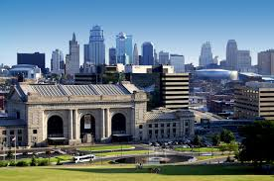
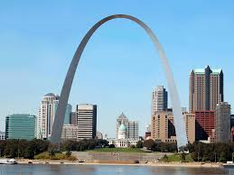
What’s the Difference?
Cheating the Insurance Company
Cheating the Customer
KANSAS CITY
ST. LOUIS
Notes:
Bullet Points:
Explain how Going to Denver is no different than going to Colorado Springs. Just like cheating the insurance company is no different than cheating the customer. If someone is willing to lie about one thing, they will lie about everything.
Transition: We provide all these services with NO RISK TO YOU!!

Slide 26
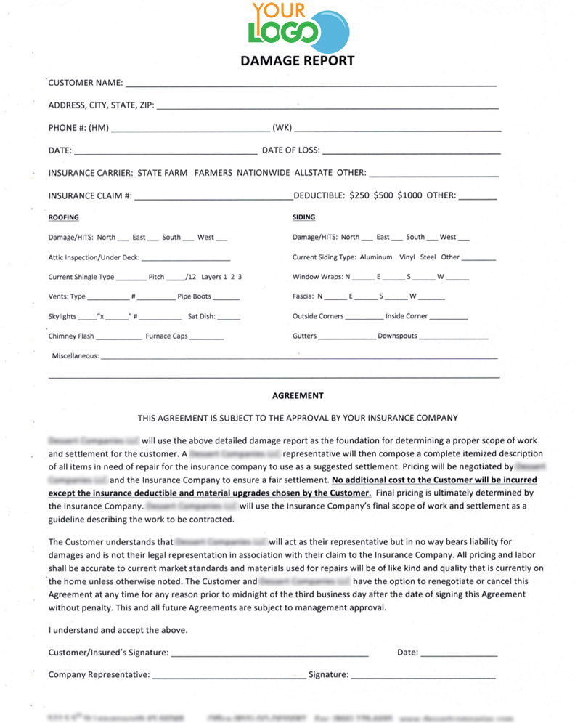
Customer Protection Form
Notes:
Bullet Points:
This is our contingency contract and it lets you know that we work for what the insurance contract pays. You are not liable for anything other than your deductible when the roof gets approved. Sounds like a win all the way around.
Transition: When you think about it, why wouldn't you go with Exceptional?

Slide 27
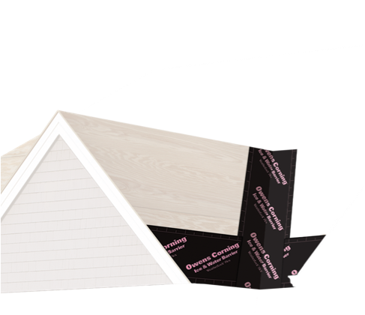
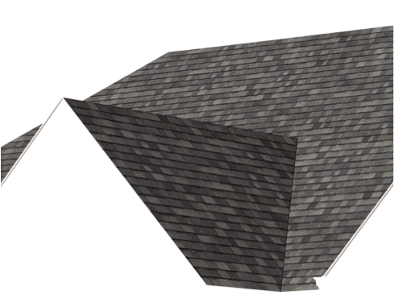
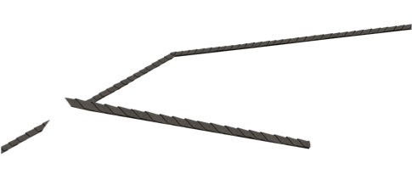
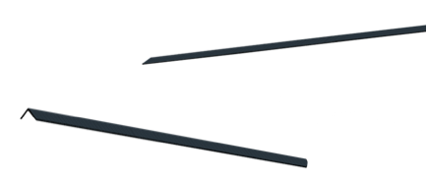
For the Preferred Protection Warranty these products must be used
Ice and Water Shield
Synthetic Underlayment
Premium Shingles
Starter Shingles
Vent
Notes:
Bullet Points:
This is a visual that helps you to explain how to get the preferred protection warranty.
This is when you take your parts and pieces out of your bag and explain the materials to them. Make sure you put the samples in their hands. This is what we call “selling to the senses”
Transition: Let me tell you a little more about the warranty.

Slide 28
Non-Prorated Warranty
+
Preferred Protection Warranty
Standard Warranty
Supreme
5 Years
15 Years
Oakridge
10 Years
50 Years
Duration
10 Years
50 Years
Notes:
Bullet Points:
Show the benefits of Standard vs Platinum Warranty. Also let them know this warranty is non-prorated.
Transition: Let me show you what our work looks like

Slide 29
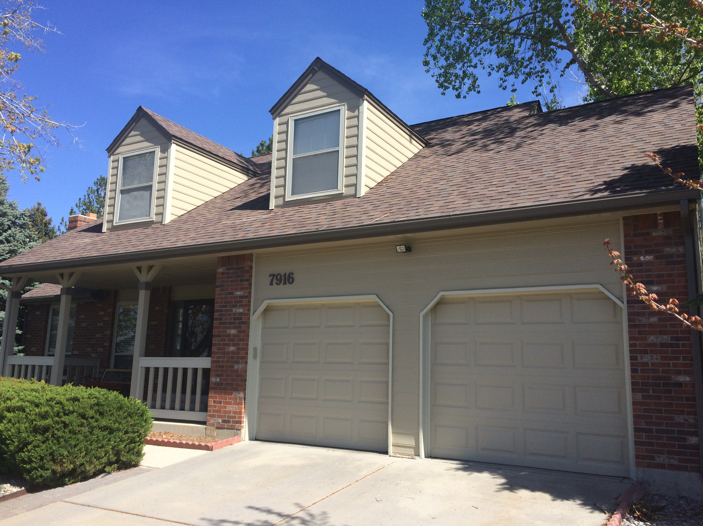
BEFORE
Notes:
Bullet Points:
Show them a before and after
Transition: Thats why most of our customers think the only choice is Exceptional Exteriors.

Slide 30
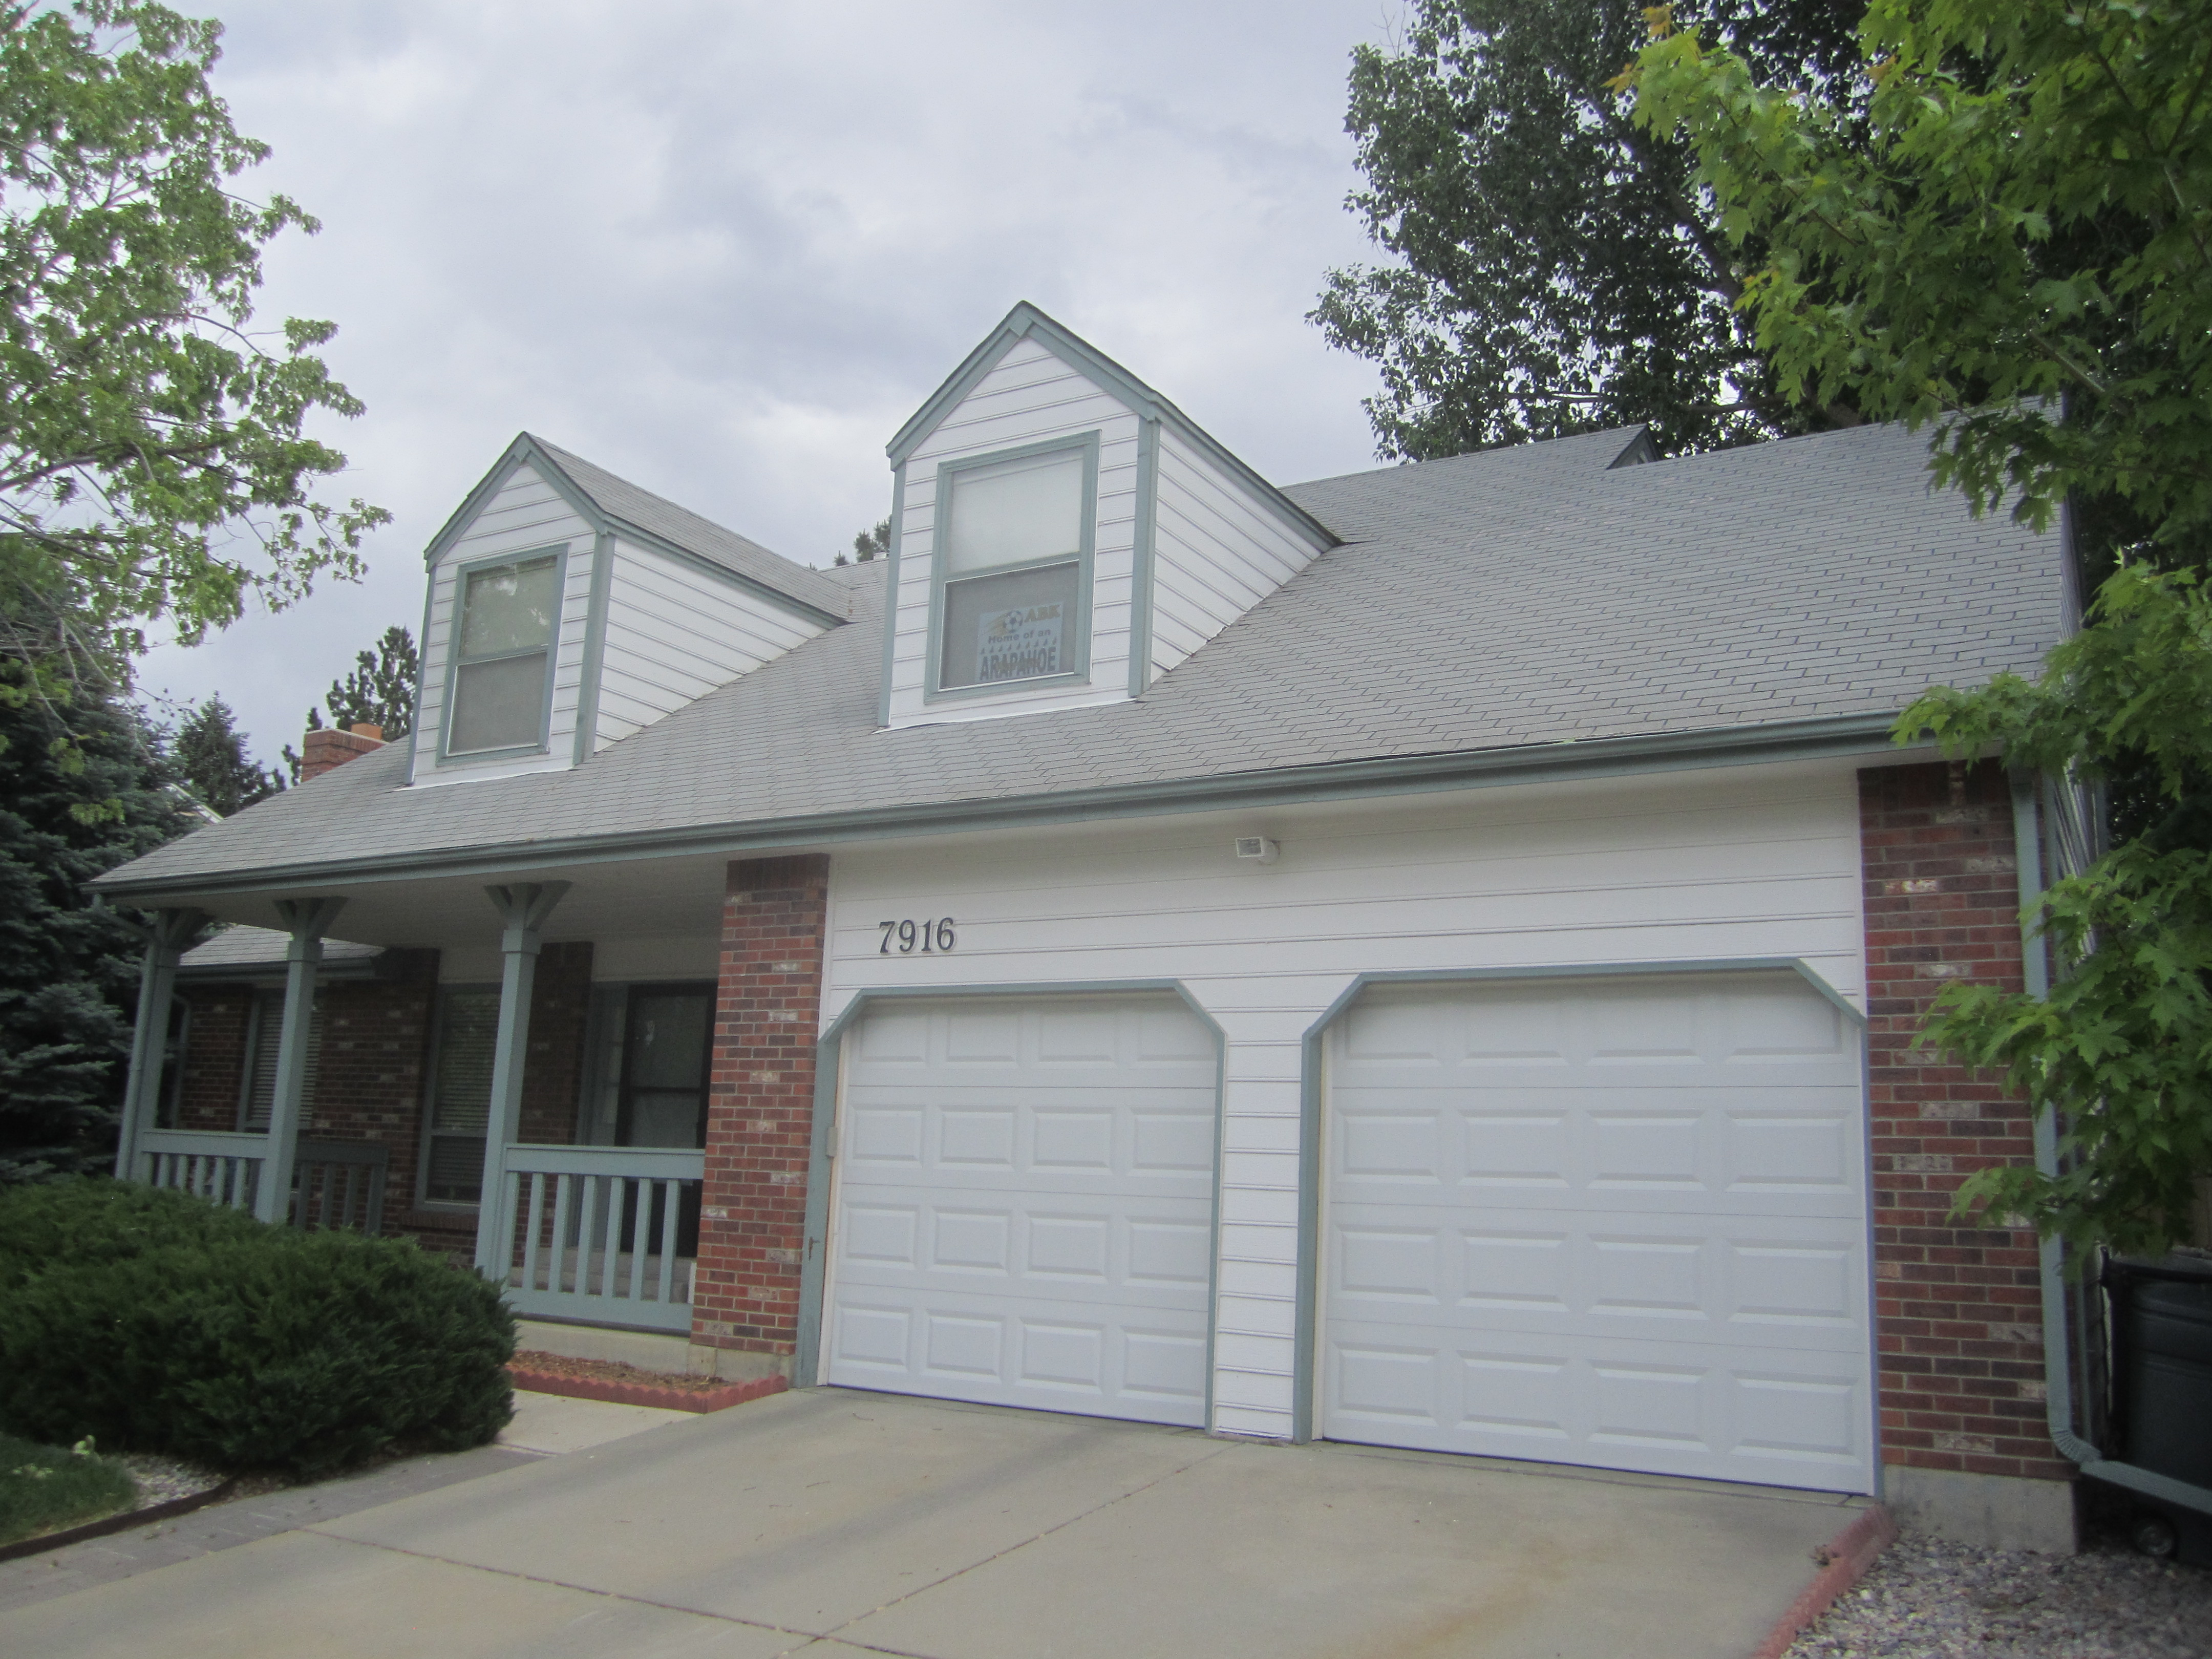
AFTER
Notes:
Bullet Points:
Show them a before and after
Transition: Thats why most of our customers think the only choice is Exceptional Exteriors.

Slide 31
Notes:
Bullet Points:
This is a wrap up slide. Move on to step 7

